Slide 1
Climate Change
Citizens For Our Children’s Future

Slide 2
What is climate?
Climate is the average or typical weather ¹
Weather is the short-term changes in temperature
Climate in the equator is warm; North pole is cold
Citizens
For Our Children’s Future

Slide 3
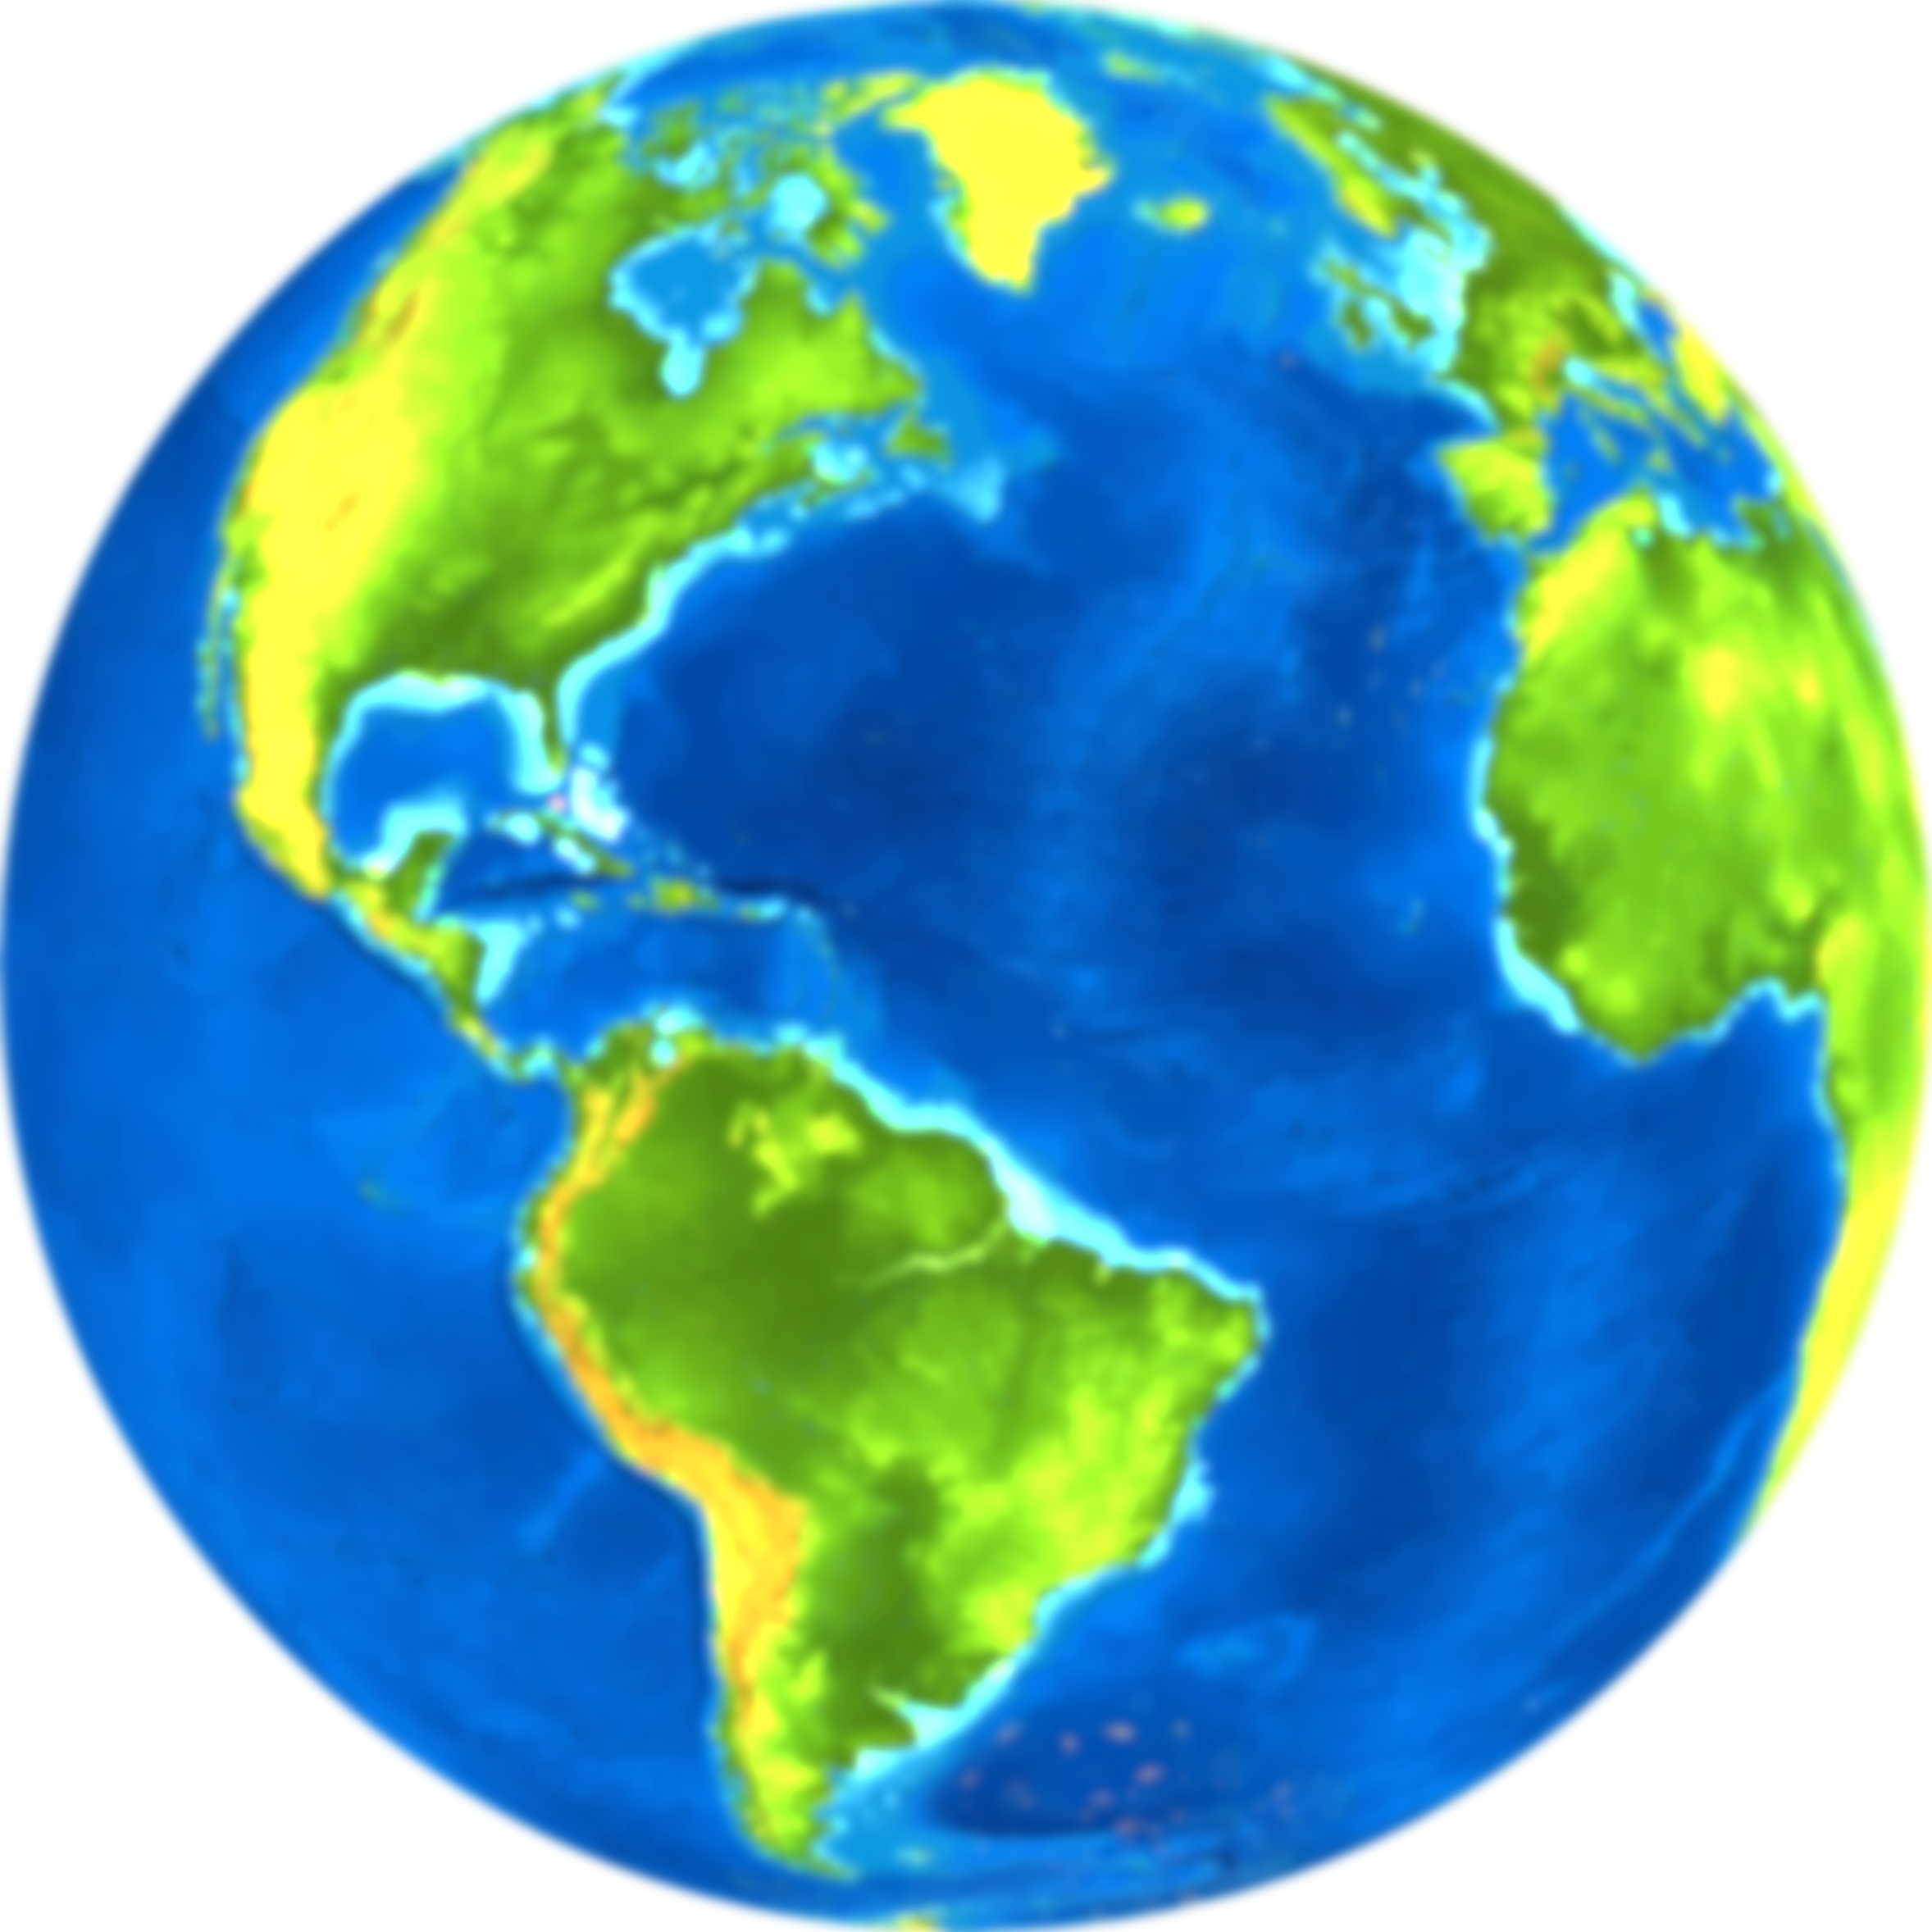
What is Climate Change?
Change in Earth’s overall climate ²
Increase in temperature
The planet is warming due to human-related activities
Citizens
For Our Children’s Future

Slide 4
Impacts on You
Climate change affects everyone in the world
In America, we experience longer summers and shorter winters
Heavier rainfall causing more floods than before
Other areas experience droughts
Citizens
For Our Children’s Future

Slide 5
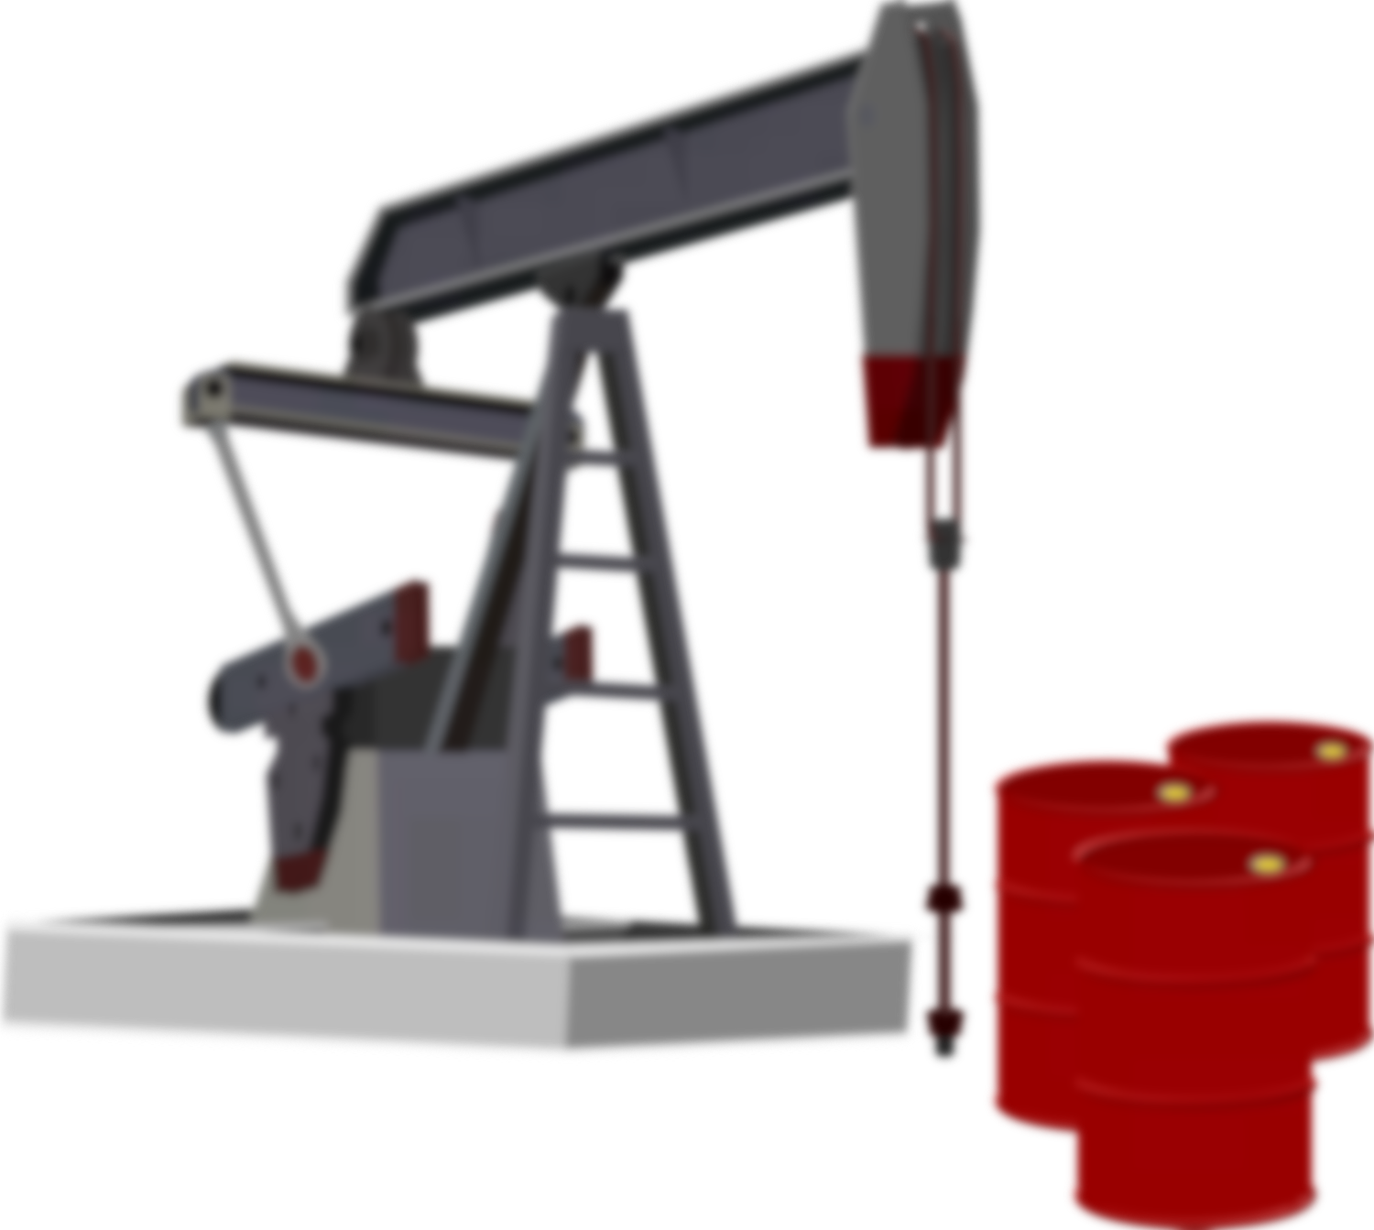
Causes of climate change
Rising concentrations of carbon dioxide in atmosphere
Burning of coal, oil, and gases increase carbon dioxide
Carbon dioxide prevents heat from leaving Earth
Leads to rise temperatures all over the world
Citizens
For Our Children’s Future

Slide 6

Excessive Heat
More areas face droughts
Increase in wildfires
Pollute the environment
Accelerate climate change
Citizens
For Our Children’s Future

Slide 7
Excessive Heat
Increase amount heat-related illnesses such as ³:
Heat strokes
Heat cramps
Heat rashes
Heat Exhaustion
Citizens
For Our Children’s Future

Slide 8
Agriculture Sector Affected
The U.S. has agricultural industry producing $330 billion per year ⁴
Agricultural systems depend very heavily on weather
Negative impacts on weather endanger agricultural industry
Our food comes from agriculture
Citizens
For Our Children’s Future

Slide 9
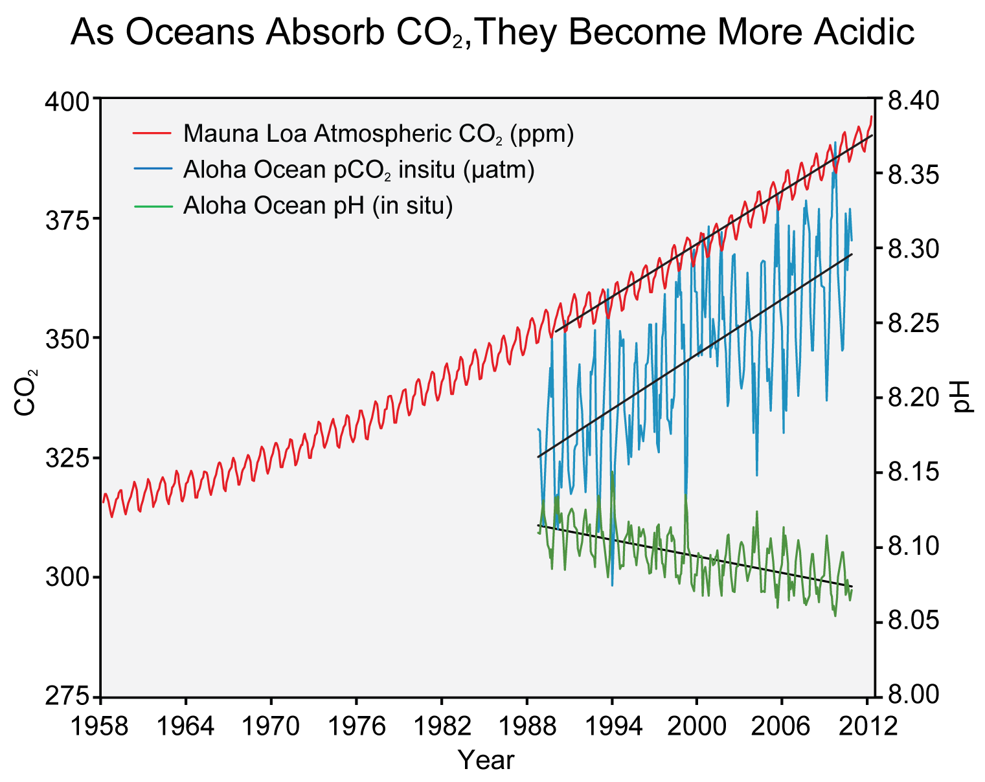
Ocean Life Threatened
Carbon dioxide is interacting with ocean water
Water is turning acidic
Citizens
For Our Children’s Future

Slide 10
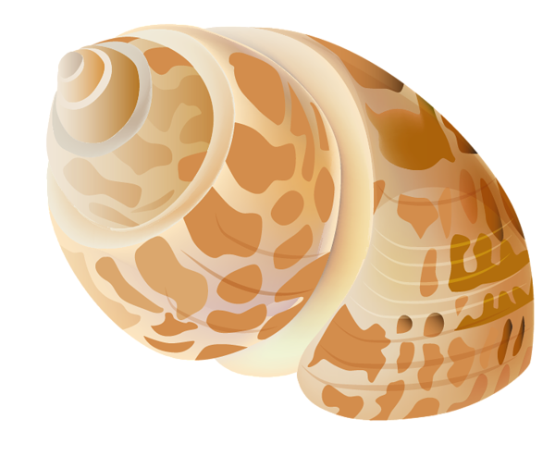
Ocean Life Threatened
Life forms with shells and skeletons not growing and reproducing normally
Marine food chain is affected
Citizens
For Our Children’s Future

Slide 11
What You Can Do
Spread the word about climate change
Study found half of the elderly disagree scientist think Earth is warming due to human activities
Citizens
For Our Children’s Future

Slide 12

What You Can Do
Use your car less often
Ride a bike or take public transportation
Reduce air pollution that strengthen climate change
Citizens
For Our Children’s Future

Slide 13
Citations
May, Sandra. 2015. What Are Climate and Climate Change? September 16. Accessed December 1, 2016. https://www.nasa.gov/audience/forstudents/5-8/features/nasa-knows/what-is-climate-change-58.html.
Dictionary.com. n.d. climate change. Accessed December 1, 2016. http://www.dictionary.com/browse/climate-change.
OSHA. n.d. Occupational Heat Exposure. Accessed December 1, 2016. https://www.osha.gov/SLTC/heatstress/heat_illnesses.html.
U.S. Global Change Research Program. 2014. National Climate Assessment. Accessed December 1, 2016. http://nca2014.globalchange.gov/highlights/overview/overview#intro-section-2.
Red bicycle. http://health.hawaii.gov/injuryprevention/files/2013/09/bike_red1.png
Shell. https://s-media-cache-ak0.pinimg.com/originals/2c/d0/e1/2cd0e1155f2c9ff416573f8ed9e5d2b0.png
Fire. http://www.imsheatingandair.com/assets/img/icon-red-heat.png
Oil. http://www.clipartkid.com/images/795/12-oil-rig-cartoon-design-free-cliparts-that-you-can-download-to-you-27ZFaE-clipart.png

